Slide 1
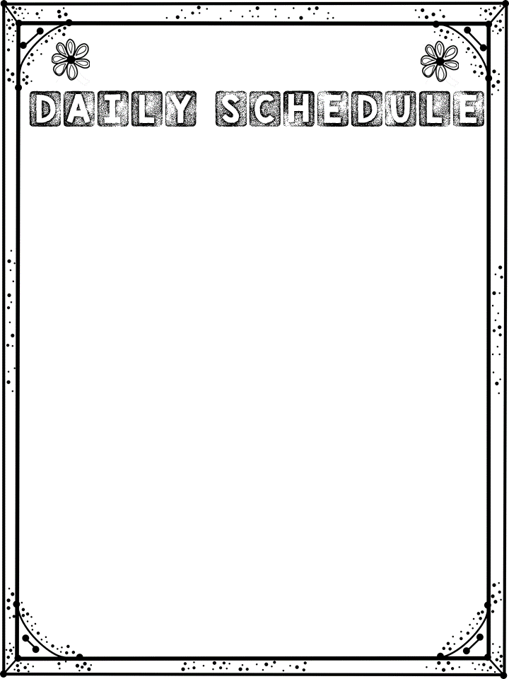
Mrs. Turner’s
Time | Subject
7:55- 8:40 | CKLA: Listening and Learning
8:45-9:30 | Specials
9:35-10:35 | CKLA: Skills
10:35-10:55 | Science/ SS
10:55-11:35 | Lunch
11:45-12:15 | Recess
12:20-12:50 | ELA W.I.N.
12:50-1:50 | Eureka Math
1:50-2:20 | Math W.I.N.

